Slide 1
Collecting and storing data from Internet-based sources
Workshop :
Collecting and Storing Data from Internet-Based Sources
09 May 2017
Peter Smyth
UK Data Service

Slide 2
Overview of this workshop
Getting data from the Internet using APIs
Accumulating data in a file or database for later use
Automating the processes on Windows and Linux
Notes:
Leave this for Peter

Slide 3
APIs
Description of an API
Examples of APIs
Finding and using API documentation
Browser based Demo of API usage
Code based demo of using an API
Notes:
Leave this for Peter

Slide 4
Wikipedia - API Definition
An API is a set of routines, protocols and tools for building software applications
It expresses a software component in terms of its operations, inputs, outputs and underlying types
An API defines functionalities that are independent of their respective implementations
A programmer can use the API to build an application
An API hides the complexity of implementation
Using an API allows the implementation to change, without affecting users
Notes:
Different language

Slide 5
Generic API
Application A
(a Web server)
Application B
(a program or web browser)
Request
Response
Notes:
Applications A and B could be anything
They both might :
Internal programs
Embedded software
A web service and a web browser

Slide 6
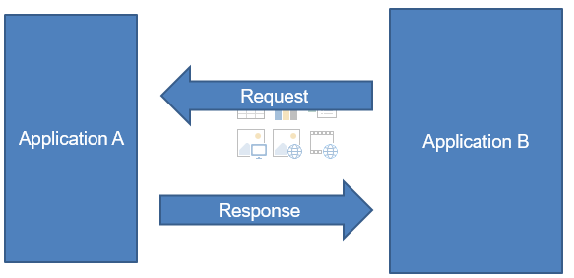
Who needs to know what?
Application B needs to be able to correctly format the requests and to be able to interpret the responses
Application A needs to be able to understand the requests and correctly return a response

Slide 7
Who doesn’t need to know what?
Application A doesn’t need know what application B does with the response
Application B doesn’t need to know how Application A create the responses from the requests

Slide 8
The flexibility of APIs
The format of the requests and responses is fixed, but beyond that:
the requester could be any of many different sources (previous slide)
the responder is free to change the manner in which the response is calculated or found

Slide 9
Who has an API ? - Some examples
Twitter
https://dev.twitter.com/
Facebook
https://developers.facebook.com/
Met Office
http://www.metoffice.gov.uk/datapoint
The Guardian
http://open-platform.theguardian.com/
Geonames API
http://api.geonames.org
Google Maps
https://developers.google.com/maps/
There are many more Google APIs, but the search API is
depreciated.

Slide 10
How do you use an API?
[Decide how to formulate the request]
Make a request
Get a response
[Work out how to interpret the response]

Slide 11
API Documentation
Essential to read and understand the API documentation
How to format requests
The format and contents of Responses
The use of keys
Limitations on use

Slide 12
API Documentation
Examples
Twitter
https://dev.twitter.com/rest/public
The Guardian
http://open-platform.theguardian.com/

Slide 13
Question
Why is a Raven like a Writing desk?
(Alice in Wonderland, Lewis Carroll)

Slide 14
Question
Why is the response to an API call like a Web page?

Slide 15
Demonstration 1
Download the ukdataservice homepage and a blog page as text in R
Code in file : dataservice_pages.R

Slide 16
JSON - Definition
JSON definition
Short for JavaScript Object Notation, JSON is a lightweight data-interchange format that is easy for humans to read and write, and for machines to parse and generate. JSON is based on the object notation of the JavaScript language.
What is JSON? Webopedia Definition
webopedia.com/term/j/json.html

Slide 17
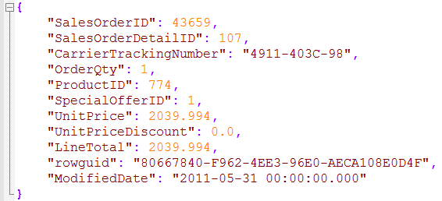
An example of simple JSON
This JSON file has been created by converting a csv file
You can always convert a csv file into JSON
Column Name
Column Value

Slide 18
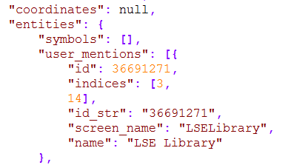
An example of complex JSON
This JSON is a very small part returned from a Twitter API call.
The nested structures “{…}” and more importantly the variable length arrays “[…]” make it very difficult to convert the JSON file into a csv file

Slide 19
An example of complex JSON
The contents of a complex JSON file is normally processed programmatically.
If you just wish to extract a few well defined fields, then the coding can be quite simple
This is often the case
But you will still need to understand the layout and types of the various fields to allow you to reference them correctly

Slide 20
Demonstration 2
An API call – try this in a browser
https://finance.google.com/finance/info?client=nasdaq&q=AAPL

Slide 21
Demonstration 2
The results (when I ran it)
// [ { "id": "22144" ,"t" : "AAPL" ,"e" : "NASDAQ" ,"l" : "148.96" ,"l_fix" : "148.96" ,"l_cur" : "148.96" ,"s": "0" ,"ltt":"4:00PM EDT" ,"lt" : "May 5, 4:00PM EDT" ,"lt_dts" : "2017-05-05T16:00:01Z" ,"c" : "+2.43" ,"c_fix" : "2.43" ,"cp" : "1.66" ,"cp_fix" : "1.66" ,"ccol" : "chg" ,"pcls_fix" : "146.53" } ]
Is, apart from the leading // in JSON format

Slide 22
Demonstration 2
Another API call – try this in IE, Chrome and Firefox
http://api.geonames.org/postalCodeCountryInfoJSON?username=PeterSmyth

Slide 23
Demonstration 2
How the results are displayed depend on the browser
The text returned is JSON
The different browsers have different ways of displaying the JSON text.
IE cannot cope at all
Even Microsoft Edge, just treats the JSON as a continuous string of character.

Slide 24
Demonstration 3 - googlefinance.py
Using the googlefinance API in Python
Show results to the screen
Writing the results to a file
We are using the R googlefinance module to access the API.
googlefinance determines what is returned to us
Notice that the information is different to what we got from the native API call
This could be convenience or a problem

Slide 25
Twitter Examples
You need to have a Twitter account to use the API
You need a set of 4 keys
Keys are obtained by creating an application
The starting point is https://apps.twitter.com/

Slide 26
Demonstration 4 – ws_twitter.py
The JSON returned by the Twitter API is more complex
A full tweet is very complex and can be over 4Kb in size
We will look at a simpler structure
What is trending

Slide 27
Break

